Slide 1


CONFERENCE APPLICATION
PAC 2020

Slide 2
OVERVIEW
Requirements
Backend
Persistence
Frontend
Infrastructure

Slide 3
REQUIREMENTS

Slide 4
CONFERENCE APPLICATION - REQUIREMENTS
Management of conference data
Events
Talks
Speakers
…
Multiple frontends
Web
Mobile

Slide 5
NON-FUNCTIONAL REQUIREMENTS
Scalability
High load during events expected
Dynamic cost
Monitoring
Collect
Present
Alerting
Security
Secure communication between frontend and backend
Write access to application data only for authenticated users.

Slide 6
INFRASTRUCTURE REQUIREMENTS
Container
Kubernetes

Slide 7
BACKEND

Slide 8
REST SERVICES
REST Services
Domain specific
e.g. Event
Scalability
CRUD Operations
Technology stack
Java 14 (OpenJDK)
Spring Boot 2.2.7
Container

Slide 9
PERSISTENCE

Slide 10
PLACE FOR DATA
NEO4J
Graph database management system
Nodes
Relations
Advantages
Flexibility
Performance
Version
4.0

Slide 11
FRONTEND

Slide 12
APPLICATION FRONTEND
Web Frontend
Current Frameworks
Angular
Vue.js
React
Why Angular?
Features
Available information, resources
Angular

Slide 13

BIG PICTURE
Backend
Frontend
location-service
Angular
…
person-service
NEO4J
talk-service

Slide 14
DEVELOPMENT ENVIRONMENT AND INFRASTRUCTURE

Slide 15
DEVELOPMENT ENVIRONMENT
Local Development Entvironment
IDE
No restrictions, but
Defined code conventions
Common format template
Source Code
Git (Bitbucket)
Backend
JDK 14 (OpenJDK)
Spring Boot 2.2.7
Maven

Slide 16
DEVELOPMENT ENVIRONMENT (2)
Local Development Entvironment
Frontend
Angular 9.1.6
Defined code conventions
Common format template
Minikube
For local tests

Slide 17
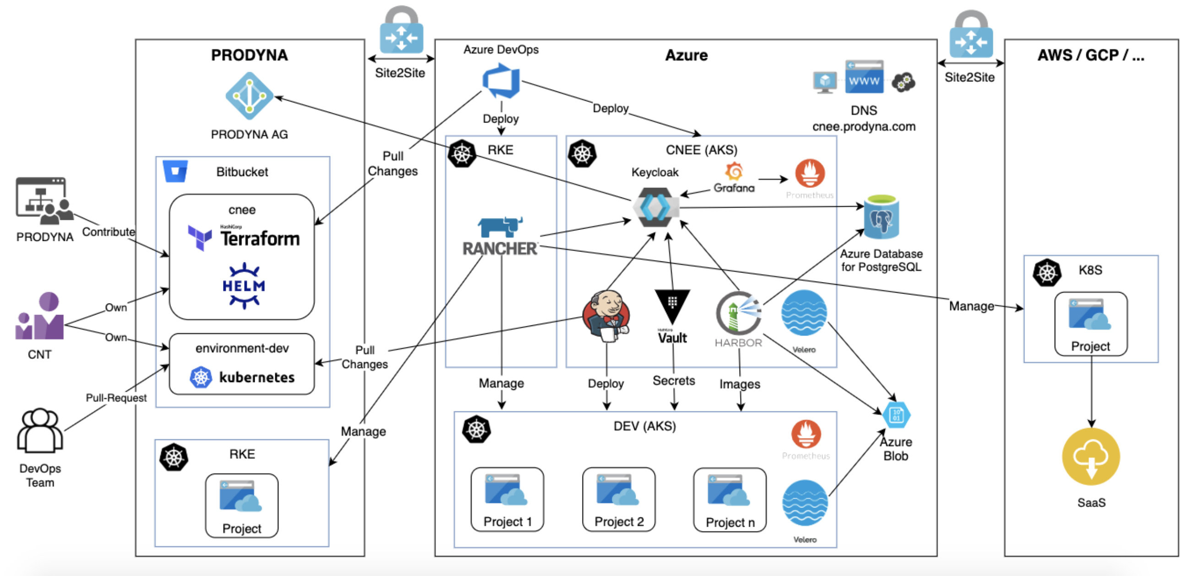
TARGET ENVIRONMENT
CNEE (Cloud-Native Engineering Environment)

Slide 18
TARGET ENVIRONMENT (2)
Definition of infrastructure with Teraform
Infrastructure Services
Monitoring
Prometheus
Grafana
Authentication & Authorization
Keycloak
Build and Deployment Prozesses
Jenkins
Pipelines

Slide 19
SUMMARY

Slide 20
SUMMARY
Management of conference data
REST services with Spring Boot
Secure communication
Authentication and Authorisation
Monitoring
Scalability
NEO4J
Performance
Fexibility

Slide 21
SUMMARY(2)
Frontend
Web Frontend with Angular
Non-Functional Requirements
CNEE
Flexible Kubernetes Environment
Scalable
Infrastructure for build and deployment processes

Slide 22
Questions?

